Slide 1


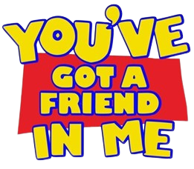





Computer Graphics (14012501) Professor: Omniah Nagoor Group Lecture: 2
Noran Almughamisi (Leader) - 443009662
Budur Alghamdi - 442006027
Aseel Keleeb - 443010223
Teif Alhrbi - 443010335
Nrdeen Sahrah - 442003298

Slide 2
Computer Graphics (14012501) Professor: Omniah Nagoor Group Lecture: 2
Noran Almughamisi (Leader) - 443009662
Budur Alghamdi - 442006027
Aseel Keleeb - 443010223
Teif Alhrbi - 443010335
Nrdeen Sahrah - 442003298

Slide 3
Computer Graphics (14012501) Professor: Omniah Nagoor Group Lecture: 2
Noran Almughamisi (Leader) - 443009662
Budur Alghamdi - 442006027
Aseel Keleeb - 443010223
Teif Alhrbi - 443010335
Nrdeen Sahrah - 442003298

Slide 4
INTRODUCTION: Many of us encounter adventures and challenges in our daily lives. Sometimes, we conquer these obstacles, leaving them behind. Other times, we emerge stronger, having learned valuable lessons. And yet, sometimes, we may struggle to overcome them at all.

Slide 5
INTRODUCTION: Many of us encounter adventures and challenges in our daily lives. Sometimes, we conquer these obstacles, leaving them behind. Other times, we emerge stronger, having learned valuable lessons. And yet, sometimes, we may struggle to overcome them at all.
Lots of times, friends can help us get through it all!!

Slide 6
INTRODUCTION: Many of us encounter adventures and challenges in our daily lives. Sometimes, we conquer these obstacles, leaving them behind. Other times, we emerge stronger, having learned valuable lessons. And yet, sometimes, we may struggle to overcome them at all.
Today, our main character, Lotso, will share his story with you.

Slide 7
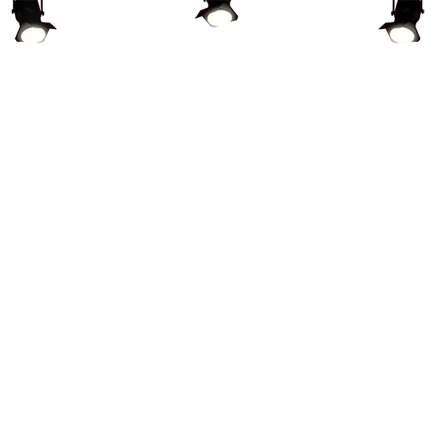
Today, our main character, Lotso, will share his story with you.

Slide 8
Today, our main character, Lotso, will share his story with you.

Slide 9
While Lotso gets ready to tell his story, let’s get to know our characters.

Slide 10
While Lotso gets ready to tell his story, let’s get to know our characters.
Woody, Jessie…

Slide 11
While Lotso gets ready to tell his story, let’s get to know our characters.
Woody, Jessie…
Alien, Mr. Potatohaed…

Slide 12
While Lotso gets ready to tell his story, let’s get to know our characters.
Woody, Jessie…
Alien, Mr. Potatohaed…
And of course… Lotso who’s hiding

Slide 13
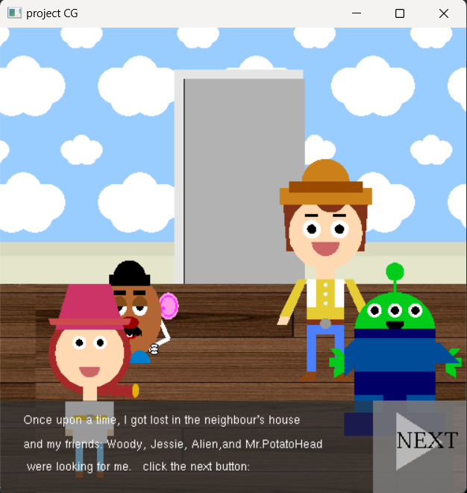
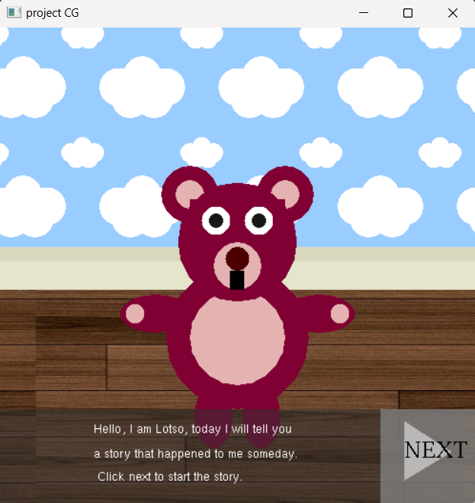
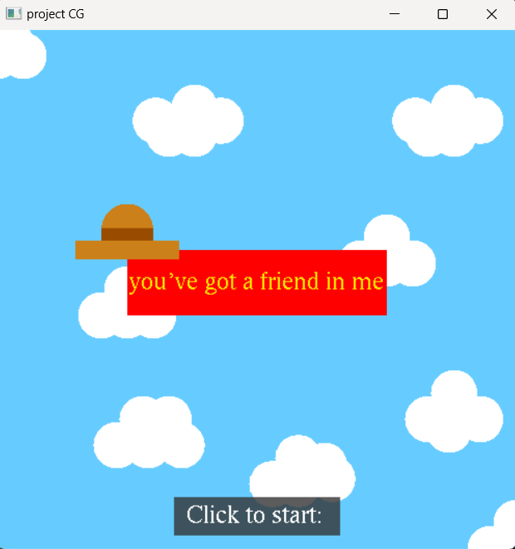
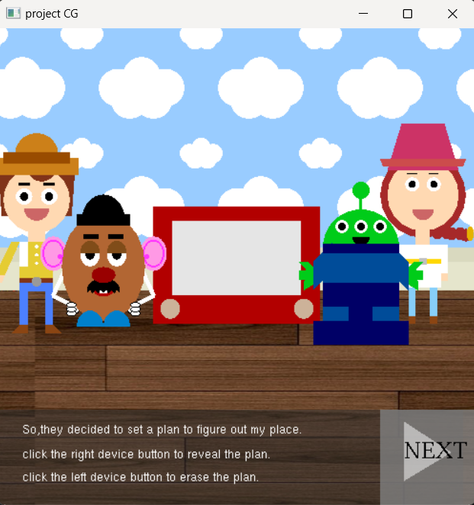
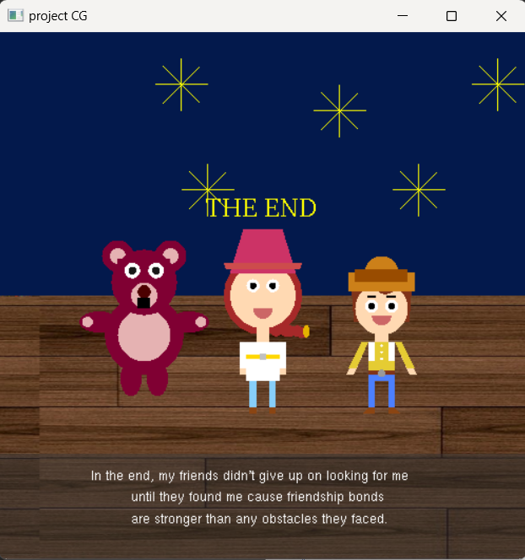
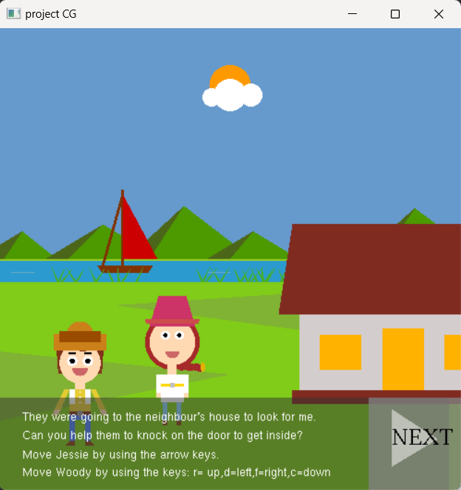
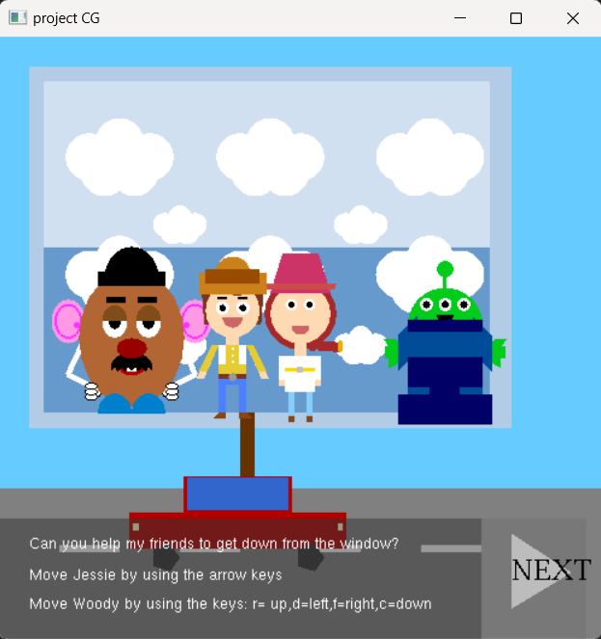
Our Project Contains 7 Scenes:

Slide 14
Our Project Contains 7 Scenes:

Slide 15
Our Project Contains 7 Scenes:

Slide 16
Our Project Contains 7 Scenes:

Slide 17
Our Project Contains 7 Scenes:

Slide 18
Our Project Contains 7 Scenes:

Slide 19
Our Project Contains 7 Scenes:

Slide 20
Our Project Contains 7 Scenes:

Slide 21
Our Project Contains 7 Scenes:

Slide 22
Our Project Contains 7 Scenes:

Slide 23
Our Project Contains 7 Scenes:

Slide 24
Our Project Contains 7 Scenes:

Slide 25
Our Project Contains 7 Scenes:

Slide 26
Our Project Contains 7 Scenes:

Slide 27
Our Project Contains 7 Scenes:

Slide 28
Lotso…

Slide 29
Are you ready now?

Slide 30
Today, our main character, Lotso, will share his story with you.

Slide 31
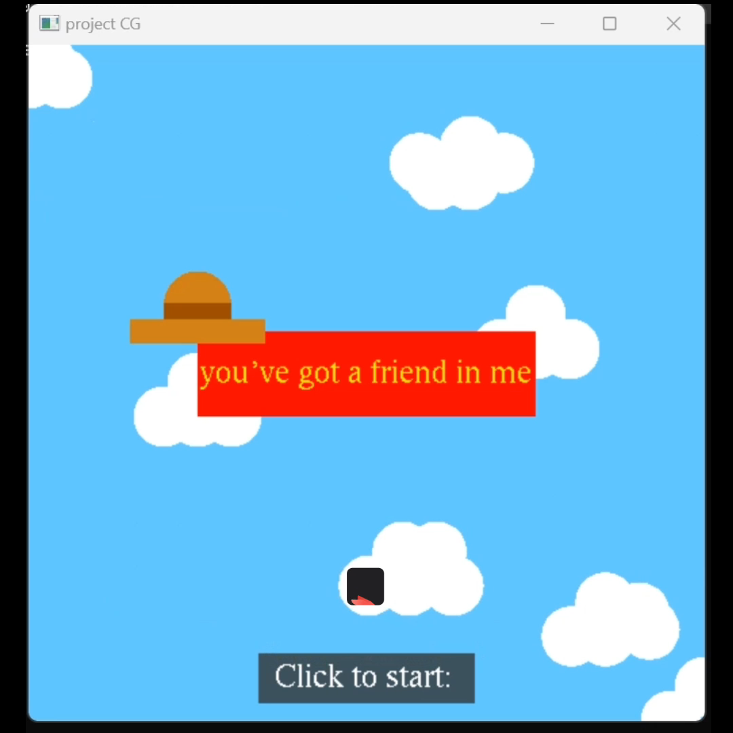
Today, our main character, Lotso, will share his story with you.

Slide 32
Today, our main character, Lotso, will share his story with you.
As a wise toy once said, friendships last 'To Infinity and Beyond!'.

Slide 33
Today, our main character, Lotso, will share his story with you.
Thank you for listening to my story and I hope you enjoyed it!
Cast:
Lotso Noran Almughamisi
Jessie Teif Alhrbi
Woody Nrdeen Sahrah
Mr. Potatohead Aseel Keleeb
Alien Budur Alghamdi
Credits:
- Drawing of a circle: https://gist.github.com/linusthe3rd/803118
- DrawString method: https://www.openglprojects.in/2012/04/tutorial-how-to-display-strings-in.html#gsc.tab=0
- Font Type: https://www.opengl.org/resources/libraries/glut/spec3/node76.html
- Texture code: https://stackoverflow.com/questions/12518111/how-to-load-a-bmp-on-glut-to-use-it-as-a-texture
- Texture image: https://www.pinterest.cl/pin/349591989837410639/
- Website to convert image to BMP: https://convertio.co/ar/jpg-bmp/
- To have a better understanding of the glRasterPos2f(x, y): https://registry.khronos.org/OpenGL-Refpages/gl2.1/xhtml/glRasterPos.xml

Slide 34
Cast:
Lotso Noran Almughamisi
Jessie Teif Alhrbi
Woody Nrdeen Sahrah
Mr. Potatohead Aseel Keleeb
Alien Budur Alghamdi
Credits:
- Drawing of a circle: https://gist.github.com/linusthe3rd/803118
- DrawString method: https://www.openglprojects.in/2012/04/tutorial-how-to-display-strings-in.html#gsc.tab=0
- Font Type: https://www.opengl.org/resources/libraries/glut/spec3/node76.html
- Texture code: https://stackoverflow.com/questions/12518111/how-to-load-a-bmp-on-glut-to-use-it-as-a-texture
- Texture image: https://www.pinterest.cl/pin/349591989837410639/
- Website to convert image to BMP: https://convertio.co/ar/jpg-bmp/
- To have a better understanding of the glRasterPos2f(x, y): https://registry.khronos.org/OpenGL-Refpages/gl2.1/xhtml/glRasterPos.xml

